Slide 1
Mutations

Slide 2
MUTATIONS
The sequence of the DNA bases serve as the instructions for the cell
Sometimes there are mistakes made when DNA copies
Mutations – changes in genetic material

Slide 3
Mutations that causes a change in a gene are called gene mutations
Mutations that change the whole chromosome are called chromosomal mutations

Slide 4
Gene mutations
Gene mutations involved in changes in one or more nucleotides are called point mutations, because they occur at a single point in the DNA
Point mutations:
Substitution
Insertion
Deletion

Slide 5
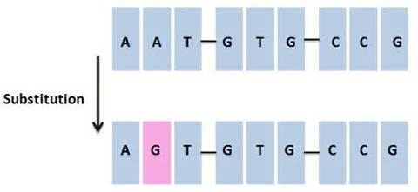
Substitution – one base is replaced by another
(not always bad…some codes redundant)

Slide 6
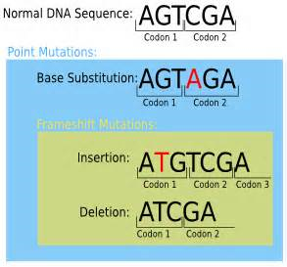
Insertion/ deletion – a base is added to the sequence/ removed from the sequence
(usually WORSE… are called frameshift mutations because they shift the “reading” of the DNA code from that point on…)

Slide 7
Chromosomal mutations
Involves change in the number or structure of chromosomes :
Types:
Deletions
Duplications
Inversions
Translocations

Slide 8
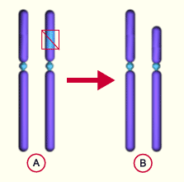
Chromosomal deletions
An entire gene is missing, not just one base but all involved in that gene

Slide 9
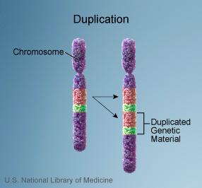
Chromosomal duplications
The entire sequence coding for the gene is in the chromosome twice

Slide 10
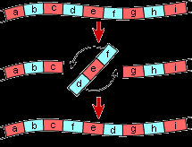
Chromosomal inversion
The genes in the chromosome in reverse direction

Slide 11
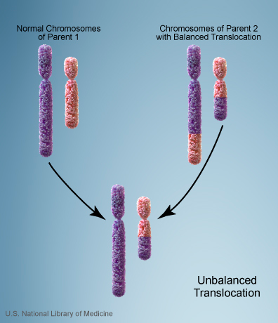
Chromosomal translocation
Part of the chromosome breaks off and becomes part of another (non homologous) chromosome

Slide 12
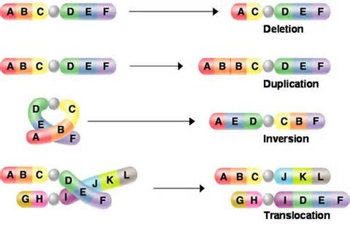

Slide 13
Formation of gametes
Gamete – sex cell (egg / sperm)
Chromosomes line up in homologous pairs to form these special reproductive cells
When they are with their match, they are referred to as tetrads .

Slide 14
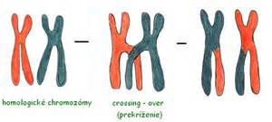
When at this stage of forming the sex cells, the chromosomes may exchange portions of themselves- crossing over

Slide 15
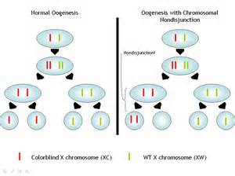
Sometime the matching pair DO NOT separate as they should, and BOTH end up in same sex cell creating an incorrect number of chromosomes in those sex cells - nondisjunction

Slide 16
Too many chromosomes or too few in an egg or sperm result in incorrect chromosome number in new organism…causes death or many disorders:
Example = down syndrome
Extra chromosome of pair 21

Slide 17
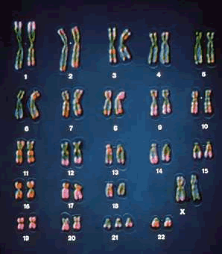
Look at the 21st pair….
Is this a boy or girl?
How many chromosomes do they have?

Slide 18
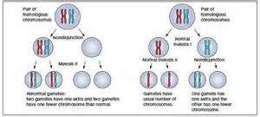
k

Slide 19
Not all mutations are bad!
Many mutations are “neutral” meaning that they do not have little effect on the cell/organism
Some create variation in the species that may be beneficial and continue to be passed on create change in the species (evolution)
Some create harmful disorders within the cell/organism

